Slide 1

PROPOSAL FOR PILOT REVIEW
Haki
Offline student information assistant for TUP Taguig.
A source-referenced, admin-governed campus guide proposed for supervised evaluation.
Offline-first
Source-referenced
Admin-governed
Prepared for TUPT administrative evaluation
Joshua Retrita | BSIT
Haki proposal for TUPT administrative review
01

Slide 2
THE CAMPUS SERVICE PROBLEM
The friction is not a lack of information. It is access.
Students often need simple guidance, but the answer may live across office posts, pages, documents, and informal advice.
1
Information is scattered
2
Students ask repeatedly
3
Offices absorb avoidable load
Office posts, pages, handbooks, room lists, and student hearsay are not one searchable service.
Basic questions reach front desks, classmates, group chats, or the wrong office.
Staff still become the last-mile explanation layer for routine campus guidance.
Stance
Haki is a student service layer first; treat AI as optional support.
Haki proposal for TUPT administrative review
02

Slide 3
WHAT HAKI ACTUALLY IS
Haki answers from approved local sources before it ever needs AI.
TUPT-approved source package
On-device SQLite + FTS
Source answer builder
Student surfaces
Documents, procedures, office guidance, citations, and update dates selected by Administration.
Searchable local index works offline and remains the baseline even without a model.
Ranks results, checks confidence, and formats the answer with citations.
Chat, Service Desk, Library, Map, and other app screens expose the guidance.
Optional local AI lane
Compatible downloaded model -> supportive/general chat and local summarization only when safe. Official campus procedures still come from saved sources.
AI is optional
Haki proposal for TUPT administrative review
03

Slide 4
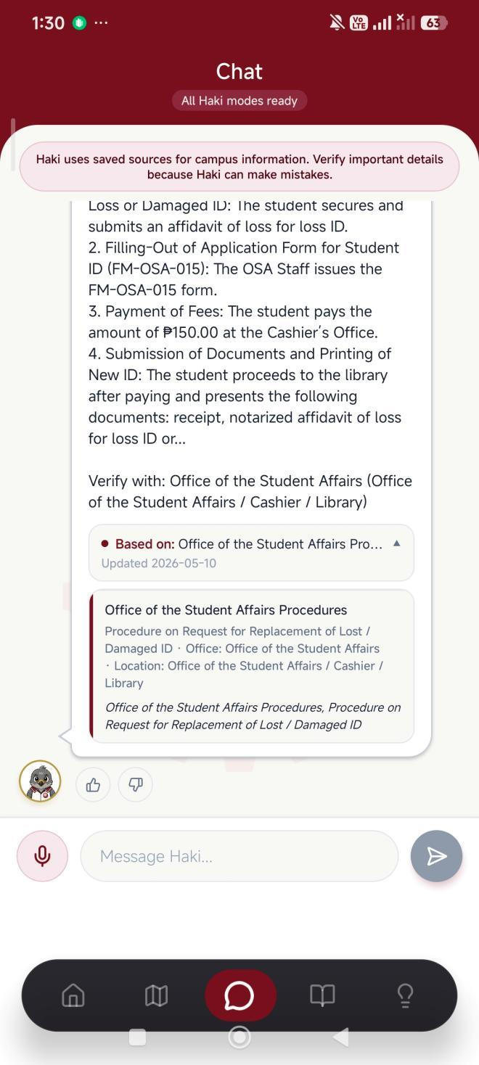
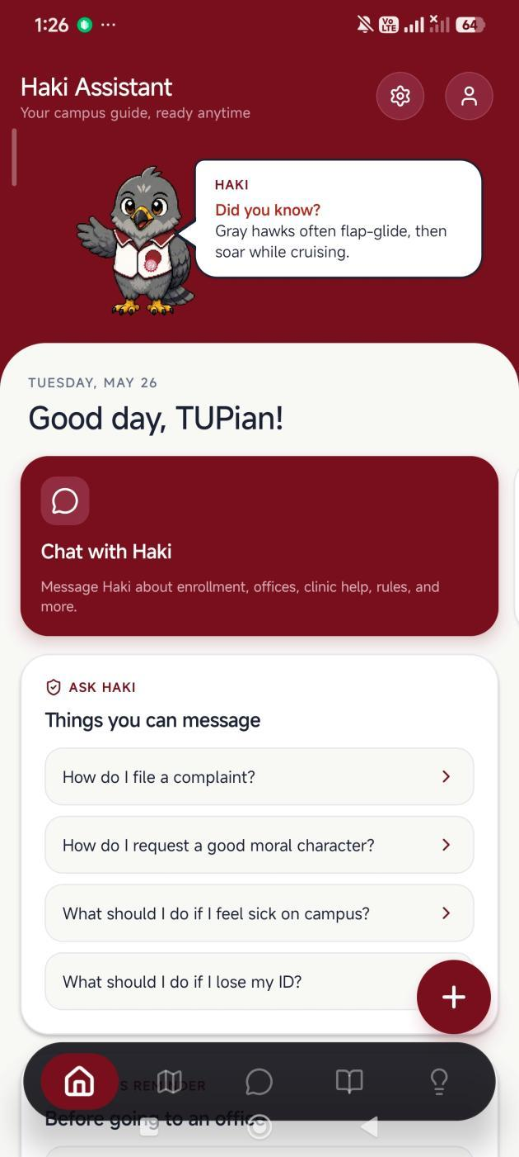
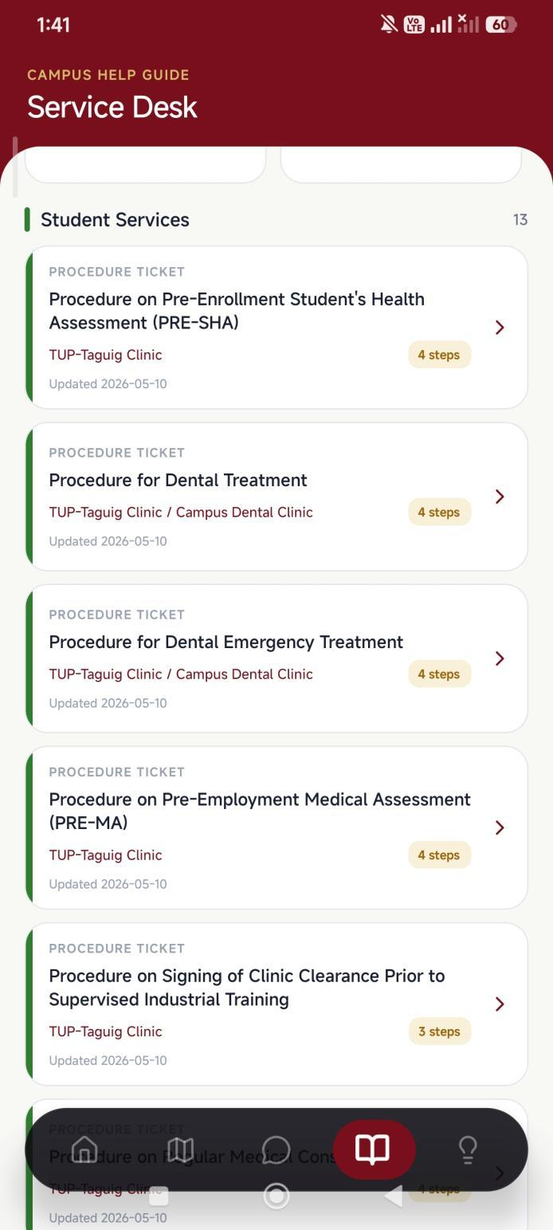
STUDENT JOURNEY
A student can move from question to source-backed next step in one flow.
1. Student home
3. Service desk topics
2. Source-backed chat
No backend required for campus source search
Haki proposal for TUPT administrative review
04

Slide 5
TRUST MODEL
Citations make Haki auditable instead of a black-box chatbot.
Student sees the answer
The response is phrased for student action, not as raw database text.
Admin can inspect evidence
The source card names the campus document, office, and citation used by the answer.
Missing source is a signal
If official content is weak or absent, the right response is review or clarification, not guessing.
Haki is safer when it behaves like a controlled reference system, not a model pretending to know policy.
Campus answer with source panel
Haki proposal for TUPT administrative review
05

Slide 6
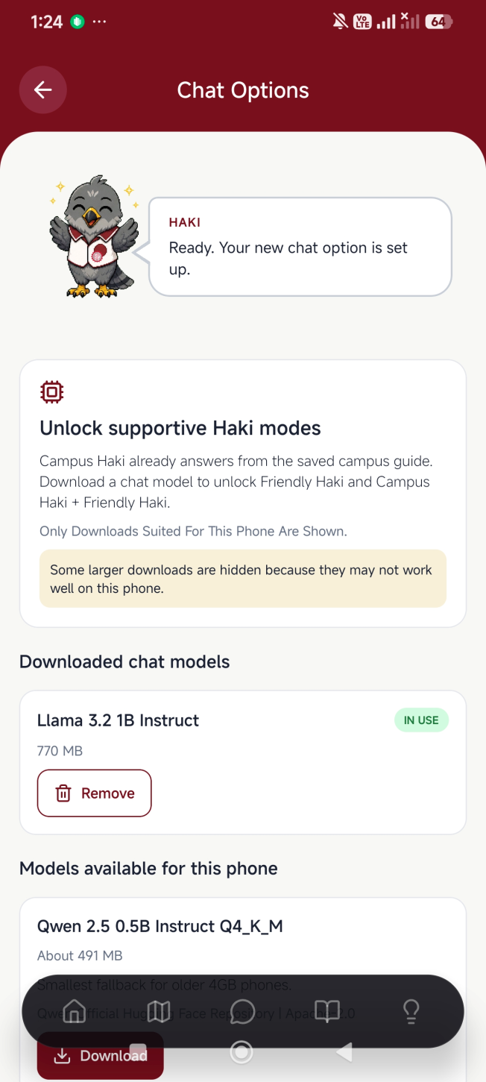
PRIVACY AND INFRASTRUCTURE
Offline-first design lowers privacy and infrastructure risk.
The proposal positions Haki as a local device app: no external chat API, no cloud database, and no server dependency for campus source search.
Inside the student's phone
Saved campus guide: Approved documents and citations
SQLite source search: Fast offline retrieval
Optional local model: Downloaded only on compatible devices
Profile/history controls: Local settings, not external server state
Official web pages remain the source for real-time announcements.
Device-aware local model screen
Haki proposal for TUPT administrative review
06

Slide 7
ADMIN GOVERNANCE
TUPT keeps ownership of the content and release decision.
Administration
Responsible office
Student or staff maintainers
Haki app
Decides whether Haki is appropriate, what content is allowed, and how distribution should be governed.
Coordinates official source review, update cadence, and policy ownership across offices.
Prepare source packages, perform updates, and preserve technical continuity under supervision.
Publishes only the approved local guide to students through chat, search, map, and library screens.
Developer role: build, hand over, guide first maintainers, and request attribution only if Haki is deployed or promoted.
Haki proposal for TUPT administrative review
07

Slide 8
COMMUNITY BENEFIT
One student app can improve service quality across the community.
Stakeholder
Current friction
What Haki improves
Students
Unsure which office to approach, what to prepare, or where to go.
Faster self-service guidance with source references and map support.
Offices
Routine questions repeat at counters and through informal channels.
Better-prepared students and fewer basic inquiries for staff.
Admin
Official guidance can be hard to keep consistent across channels.
Central content authority with local, auditable student access.
TUPT
Student-led innovation is often hard to convert into institutional value.
A visible responsible AI-era service project with controlled pilot scope.
The value is operational first: clearer guidance, less repetition, and a governable path to adoption.
Haki proposal for TUPT administrative review
08

Slide 9
LOW-RISK ADOPTION PATH
A pilot review turns adoption into a controlled administrative decision.
The ask is not a blind launch. It is permission to evaluate Haki with official content, supervision, and measured student feedback.
1
Content validation
2
Internal pilot
3
Student pilot
4
Deployment decision
Administration identifies approved offices, documents, citations, and exclusions.
Reviewing office and maintainers test answers, missing-source behavior, and update process.
Small student group tests common tasks: office concern, map, service desk, and source clarity.
Admin decides whether to publish, how to govern distribution, and who maintains it.
Decision gate after each phase: continue, revise, limit scope, or stop.
Haki proposal for TUPT administrative review
09

Slide 10

REQUESTED ADMINISTRATIVE ACTION
Approve a supervised pilot review, not a blind launch.
The proposal letter carry the formal terms. The presentation close on the next practical decision.
1
Assign a reviewing office or evaluation owner
2
Validate which campus information can be included
3
Approve a small, supervised student pilot
4
Decide distribution and maintenance after evidence
5
Confirm acceptable developer attribution if deployed
Haki remains a TUPT-controlled service candidate
Built Haki for the TUPT community, but the Administration should decide how it is reviewed, governed, and released.
Haki proposal for TUPT administrative review
10

Slide 11

DEMO SECTION
Haki App Exploration
A student walkthrough from question to campus action.
The next slides mimic how a TUPTian could use Haki during a normal campus task: ask, verify, locate, prepare, then use student-life tools when needed.
Ask
Verify
Locate
Prepare
Haki proposal for TUPT administrative review
11

Slide 12
DEMO STEP 1
A student starts from the Haki home screen.
STUDENT VIEW
The home screen gives students a starting point without hiding the app context.
Direct path to Chat
The first action points students toward asking Haki about routine campus concerns.
Suggested prompts stay visible
Common questions help new students ask in the right direction.
Navigation remains available
The full screenshot shows the bottom tabs and home context together.
Haki proposal for TUPT administrative review
12

Slide 13
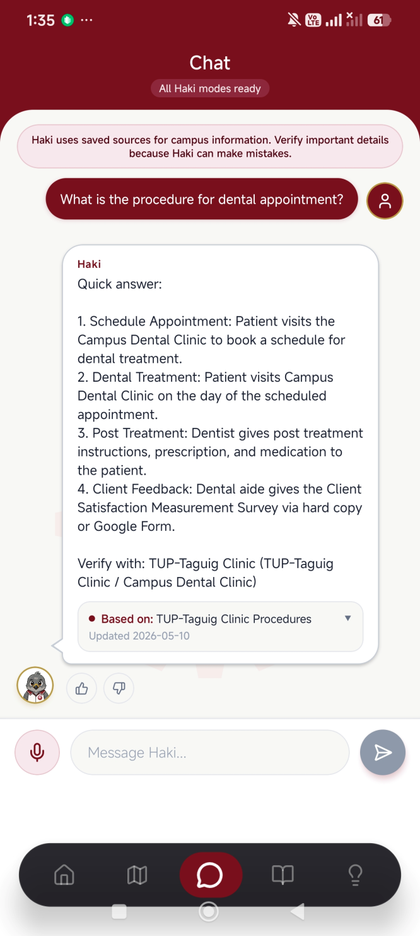
DEMO STEP 2
The student asks Haki for help.
STUDENT VIEW
The chat screen keeps the answer, warning, source card, and input area in view.
Saved sources first
The warning explains that official content should still be verified for important details.
Answer is actionable
The response is structured as steps a student can follow.
Citation is visible
The source card stays on screen so Admin can see what supported the answer.
Haki proposal for TUPT administrative review
13

Slide 14
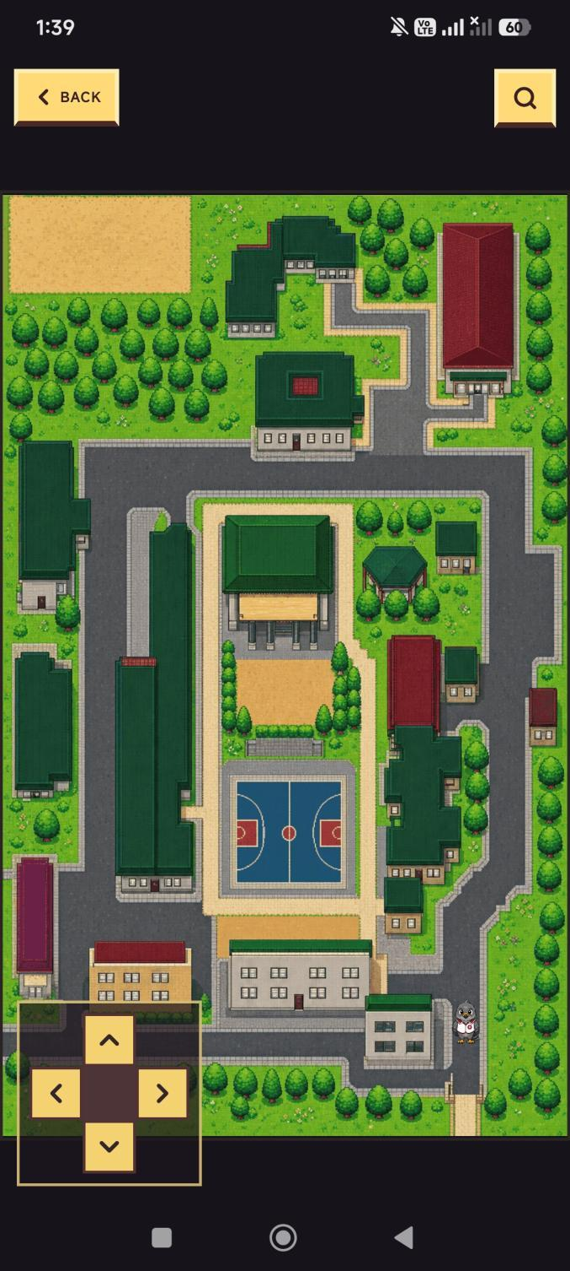
DEMO STEP 3
The student checks where to go.
MAP CONTEXT
The map becomes the next step after getting guidance.
Students can search destinations, tap buildings, and move from location context into related screens such as Service Desk or Food.
Haki proposal for TUPT administrative review
14

Slide 15
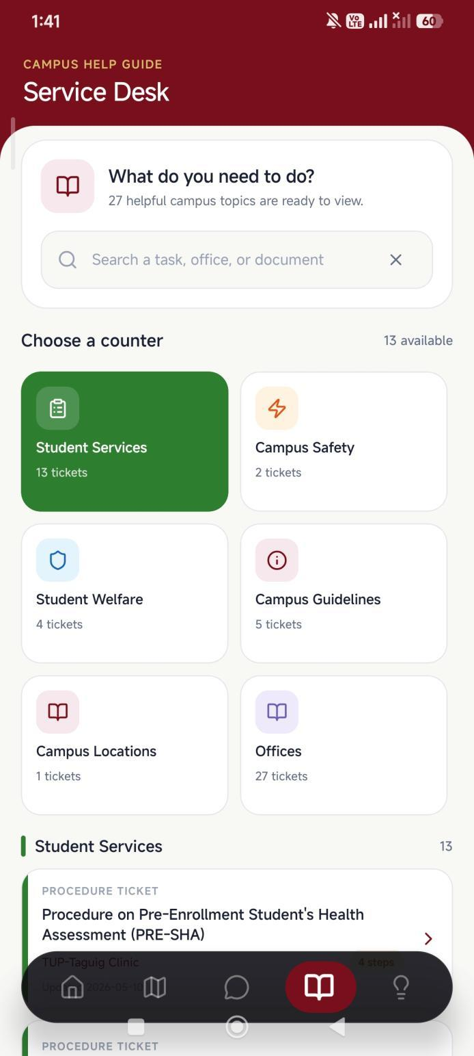
DEMO STEP 4
The student opens Service Desk when they need steps.
STUDENT VIEW
Service Desk turns campus concerns into browsable office and procedure paths.
Search by task or office
Students can search for a task, office, or document instead of guessing a category.
Counters group concerns
Student Services, Safety, Welfare, Guidelines, Locations, and Offices become visible paths.
Procedure tickets are previewed
Tickets show topic, office context, update date, and number of steps.
Haki proposal for TUPT administrative review
15

Slide 16
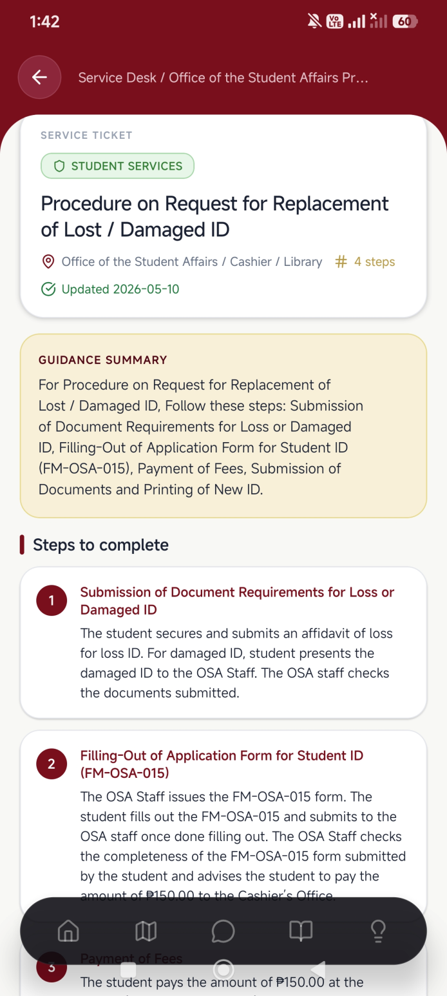
DEMO STEP 5
The student follows a procedure ticket.
STUDENT VIEW
The ticket detail view keeps requirements and step sequence visible in one place.
Step-by-step guide
Procedure content is broken into ordered actions before the office visit.
Office context is shown
The page names the office or offices involved in the concern.
Freshness is easier to review
The update date helps Admin and maintainers reason about content freshness.
Haki proposal for TUPT administrative review
16

Slide 17
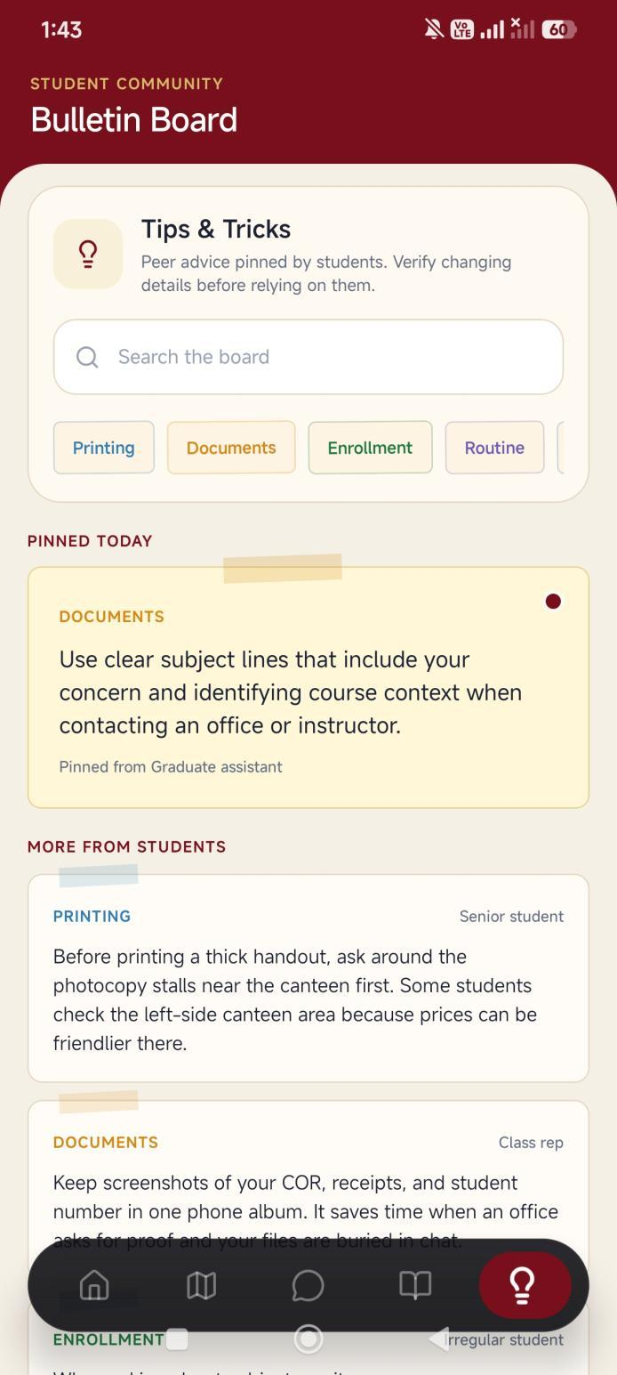
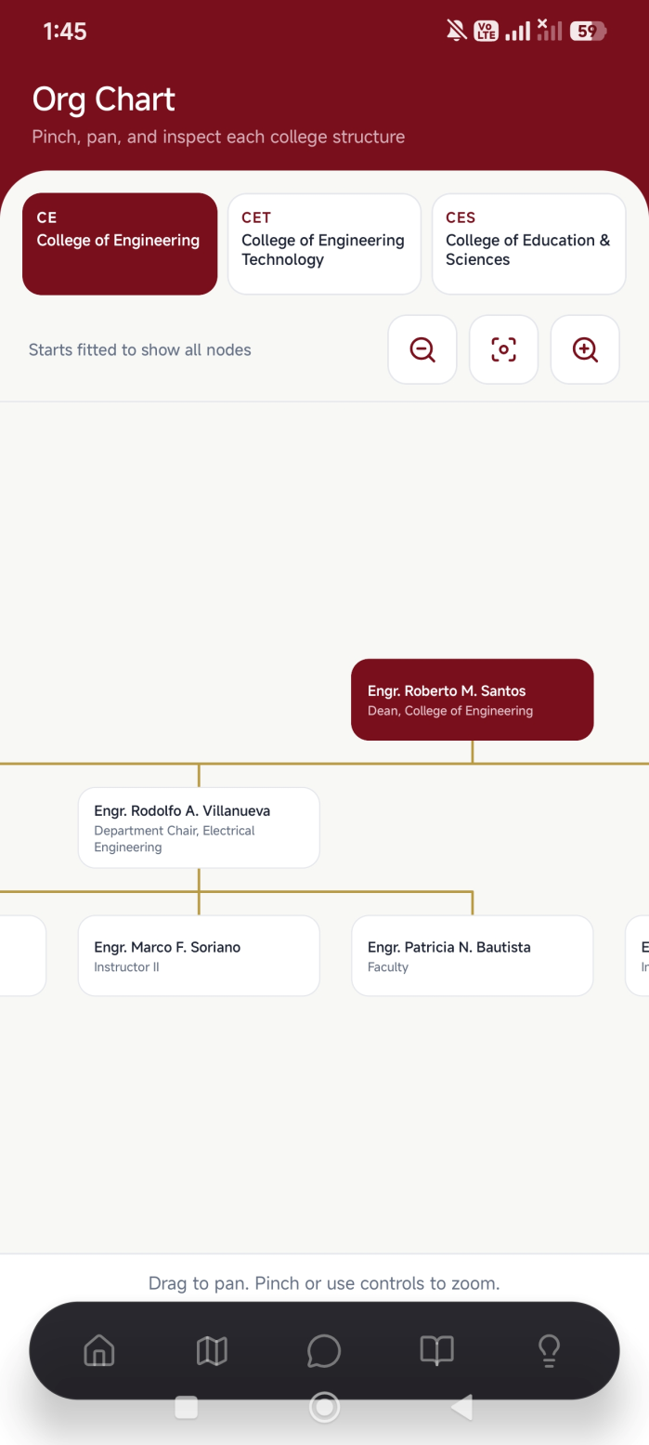
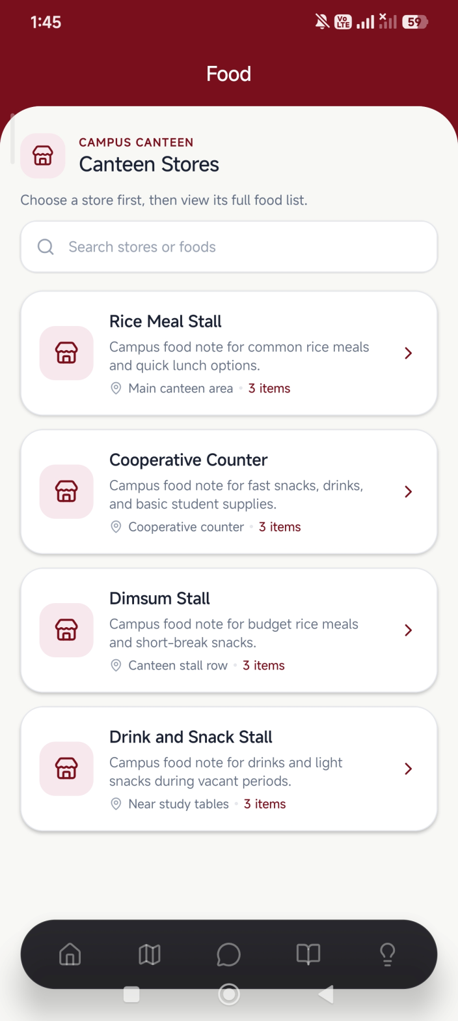
DEMO STEP 6
The student can continue into campus-life tools.
Tips
Org Chart
Food
Haki proposal for TUPT administrative review
17

